Slide 1





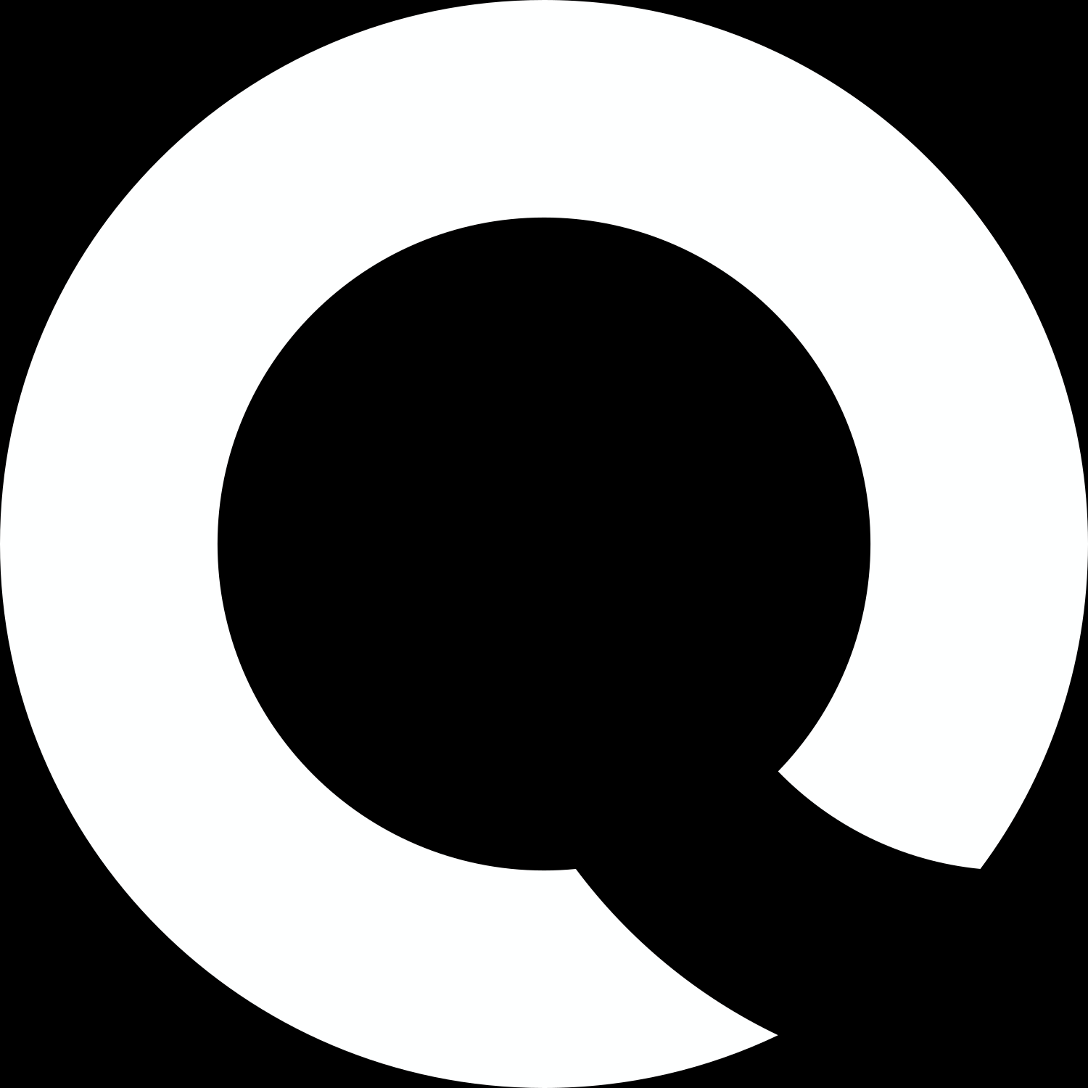
Instagram User Analytics
Data Analytics Trainee
tbhagwat29@gmail.com
Presented By:
Tushar Bhagwat

Slide 2






Marketing Analysis
Part A Marketing
Goals nº 01
Rewarding Most Loyal Users
Goals nº 02
Inactive User Engagement
Goals nº 03
Contest Winner Declaration

Slide 3

Marketing Analysis
Part A Marketing
Goals nº 04
Hashtag Research
Goals nº 05
Ad Campaign Launch

Slide 4

Investor Metrics
Part B Marketing
Goals nº 01
User Engagement
Goals nº 02
Bots & Fake Accounts
Software Use
MySQL Workbench 8.0 CE

Slide 5



Marketing
Rewarding most Loyal User
People who have been using the platform for the longest time.(Top 5 oldest Instagram users)
1. We will use the data from the users table by selecting the username and created_at columns.
2. Then using the order by function we will order the desired output by sorting with the created_at column in ascending order.
3. Then using the limit function, the output will be displayed for top 5 oldest Instagram users.

Slide 6
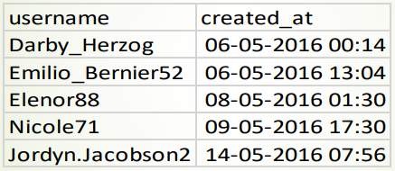
Marketing
Rewarding most Loyal User
Program Query
select username,
created_at from users order by created_at ASC limit 5;
Output

Slide 7
Marketing
Remind Inactive Users to Start Posting
Remind Inactive users to Start Posting(Users who never posted a single photo on Instagram)
1. We will first select username column from the users table.
2. Then we will left join photos table on the users table, on users.id = photos.user_id because, both the users.id and photos.user_id have common contents in them.
3. Then we will find rows from the users table where the photos.id IS NULL

Slide 8
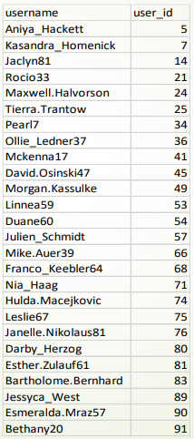
Marketing
Rewarding most Loyal User
Program Query
select username, users.id as user_id
from users
left join photos
on users.id = photos.user_id
where photos.id IS NULL
order by users.id;
Output
So, there are in total 26 users of the 100 users who have never posted a single photo on Instagram

Slide 9
Marketing
Declaring Contest Winner
The team started a contest and the user who gets the most likes on a single photo will win the contest now they wish to declare the winner. Identify the winner of the contest and provide their details to the team
1. First we will select the users.username, photos.id, photos.image_url and count(*) as total
2. Then, we will inner join the three tables wiz : photos, likes and users, on likes.photo_id = photos.id and photos.user_id = users.id
3. Then, by using group by function we will group the output on the basis of photos.id
4. Then, using order by function we will sorting the data on the basis of the total in descending order
5. Then, to find the most liked photo we will using limit function to view only the top liked photo’s information

Slide 10
Marketing
Declaring Contest Winner
The team started a contest and the user who gets the most likes on a single photo will win the contest now they wish to declare the winner. Identify the winner of the contest and provide their details to the team
select users.id as user_id, users.username, photos.id as photo_id,
photos.image_url, count(*) as total
from photos
inner join likes
on likes.photo_id = photos.id
inner join users
on photos.user_id = users.id
group by photos.id
order by total DESC
limit 1;

Slide 11
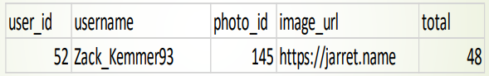
Marketing
Declaring Contest Winner
Output/Winner
So, the user named Zack_Kemmer93 with user_id 52 is the winner of the contest cause his photo with photo_id 145 has the highest number of likes i.e. 48

Slide 12
Marketing
Hashtag Researching
A partner brand wants to know, which hashtags to use in the post to reach the most people on the platform.(Top 5 commonly used #Hashtags on Instagram )
1. We need to select the tag_name column from the tag table and the count(*) as total function so as to count the number of tags used individually.
2. Then, we need to join tags table and photo_tags table, on tags.id = photo_tags.tag_id cause they contain the same content in them i.e. tag_id
3. Then using the group by function we need to group the desired output on the basis of tags.tag_name
4. Then using the order by function we need to sort the output on the basis of total(total number of tags per tag_name) in descending order
5. Then, to find the top 5 most used tag names we will use the limit 5 function.

Slide 13
Marketing
Hashtag Researching
A partner brand wants to know, which hashtags to use in the post to reach the most people on the platform.(Top 5 commonly used #Hashtags on Instagram )
select tags.tag_name, count(*) as total_number_of_times_tag_used_individually
from tags
join photo_tags
on tags.id = photo_tags.tag_id
group by tags.tag_name
order by total_number_of_times_tag_used_individually DESC
limit 5;

Slide 14
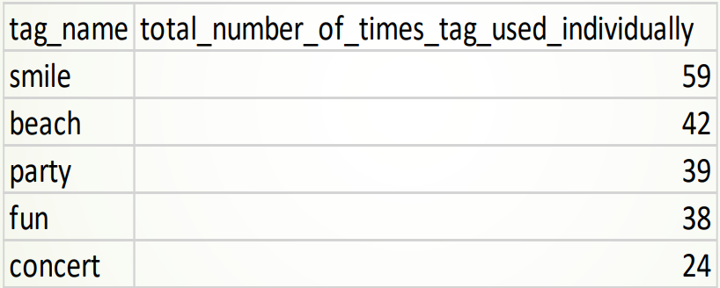
Marketing
Hashtag Researching
A partner brand wants to know, which hashtags to use in the post to reach the most people on the platform.(Top 5 commonly used #Hashtags on Instagram )
Output

Slide 15
Marketing
Launch AD Campaign
The team wants to know, which day would be the best day to launch ADs. (What day of the week do most users register on?)
1. First we define the columns of the desired output table using select dayname(created_at) as day_of_week and count(*) as total_number_of_users_registered from the users table
2. Then using the group by function we group the output table on the basis of day_of_week
3. Then using the order by function we order/sort the output table on the basis of total_number_of_users_registered in descending order

Slide 16
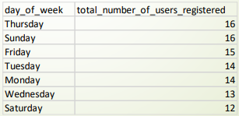
Marketing
Launch AD Campaign
The team wants to know, which day would be the best day to launch ADs. (What day of the week do most users register on?)
select dayname(created_at) as day_of_week,
count(*) as total_number_of_users_registered
from users
group by day_of_week
order by total_number_of_users_registered DESC;

Slide 17
Marketing
Launch AD Campaign
The team wants to know, which day would be the best day to launch ADs. (What day of the week do most users register on?)
Most of the users registered on Thursday and Sunday i.e. 16 and hence it would prove beneficial to start AD Campaign on these two days

Slide 18
Investor Metrics
User Engagement
Are users still as active and post on Instagram or they are making fewer posts. How many times does average user posts on Instagram? Also, provide the total number of photos on Instagram/total number of users.
1. First, we need to find first the count number of photos(posts) that are present in the photos.id column of the photos table i.e. count(*) from photos
2. Similarly, we need to find the number of users that are present in the users.id column of the users table i.e. count(*) from users
3. Next, we need to divide both the values i.e. count(*) from photos/count(*) from users and hence we would get the total number of photos / total number of users
4. To find how many times the users posts on Instagram we need to find the total occurrences of each user_id in photos table

Slide 19
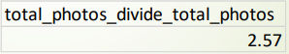
Investor Metrics
User Engagement
Are users still as active and post on Instagram or they are making fewer posts. How many times does average user posts on Instagram? Also, provide the total number of photos on Instagram/total number of users.
Program/Query to find (total number of photos/total number of users) :
select
(select count(*) from photos)/(select count(*) from users) as
total_photos_divide_total_photos;
Output

Slide 20
Investor Metrics
User Engagement
Are users still as active and post on Instagram or they are making fewer posts. How many times does average user posts on Instagram? Also, provide the total number of photos on Instagram/total number of users.
Program/Query to find the times each user posts on Instagram :
select user_id,count(*) as user_post_count
from photos
group by user_id
order by user_id;
Output

Slide 21
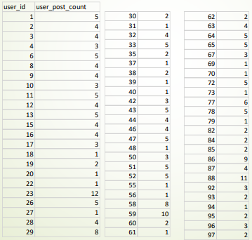
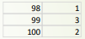
Investor Metrics
User Engagement
So the user_id along with the number of times each user_id has posted is provided.

Slide 22
Investor Metrics
Bots and Fake Accounts
The investors want to know if the platform is crowded with fake and dummy accounts. Provide data on users (bots) who have liked every single photo on the site (since any normal user would not be able to do this).
1. First, we select the user_id column from the photos table
2. Then we select the username column from the users table
3. Then, we select the count(*) function to count total number of likes from the likes table
4. Then we inner join users and likes table on the basis of users.id and likes.user_id, using the on function/clause
5. Then by using the group by function we group the desired output table on the basis of likes.user_id
6. Then, we search for the values from the cout(*) from photos having equal values with the total_likes_per_user

Slide 23
Investor Metrics
Bots and Fake Accounts
The investors want to know if the platform is crowded with fake and dummy accounts. Provide data on users (bots) who have liked every single photo on the site (since any normal user would not be able to do this).
Program/Query :
select user_id, username, count(*) as total_likes_per_user
from users
inner join likes
on users.id = likes.user_id
group by likes.user_id
having total_likes_per_user = (select count(*) from photos);

Slide 24
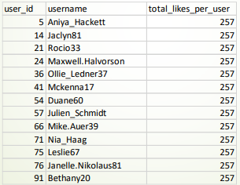
Investor Metrics
Bots and Fake Accounts
Output
So, the users along with their respective username, user_id and total_likes_per_user have been provided. This user_ids may be bots or fake accounts

Slide 25





GOT QUESTIONS?
Reach out.
tbhagwat29@gmail.com
Calle Cualquiera 123, Cualquier Lugar

